Slide 1

Sainsbury’s Sales Overview: Region 5
By
Nectar360 Data Team:
Gajan Kanagenthiran

Slide 2
Introduction
Objectives
Data Set Overview
Sales Performance Analysis
Customer Segmentation and Behaviour Analysis
Insights and actions #1
Insights and actions #2
Insights and actions #3
Insights and actions #4
Conclusion

Slide 3
Objectives
How has the total transaction value changed and why?
How has the location of the stores affected total transaction value?
How has the type of stores affected the total transaction value?
What Product Category is the best selling, and which is the worst?
How does Transaction value vary across Nector Segments?
How has consumer behaviour changed?
How can we improve overall Transaction value based on Consumer behavior?

Slide 4
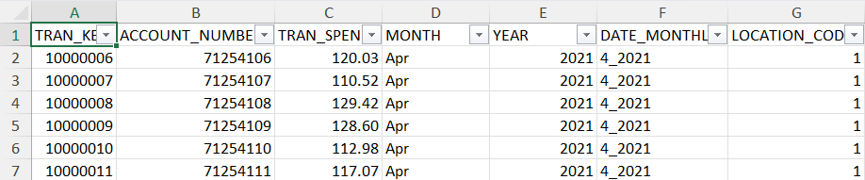
Data set Overview
About the Data Set:
The dataset spans from the 2nd quarter of 2021 to the 1st quarter of 2023.
We analyzed three sets of tables: Transactions, Location, and Customer.
Each set provided valuable insights into different aspects of sales performance and customer behavior.
Analysis Process:
Cleaned and wrangled the data on Excel
Exported as a CSV file to SQL and queried the data to obtain insights
Export the data on Power BI to visualize results and analyse trends in data.
Transactions Table (Figure 1):
Contains all transactions recorded from Q2 2021 to Q1 2023.
Includes account number, transaction value, location, and date for each transaction.
Location Table:
Provides information on store locations, regions, and store types.
Helps understand geographical distribution and market coverage.
Customer Table:
Includes Nectar segment, gender of the account holder, and shopping segmentation.
Enables segmentation analysis and understanding of customer behaviour.
Figure 1

Slide 5


Microsoft Power BI

Slide 6
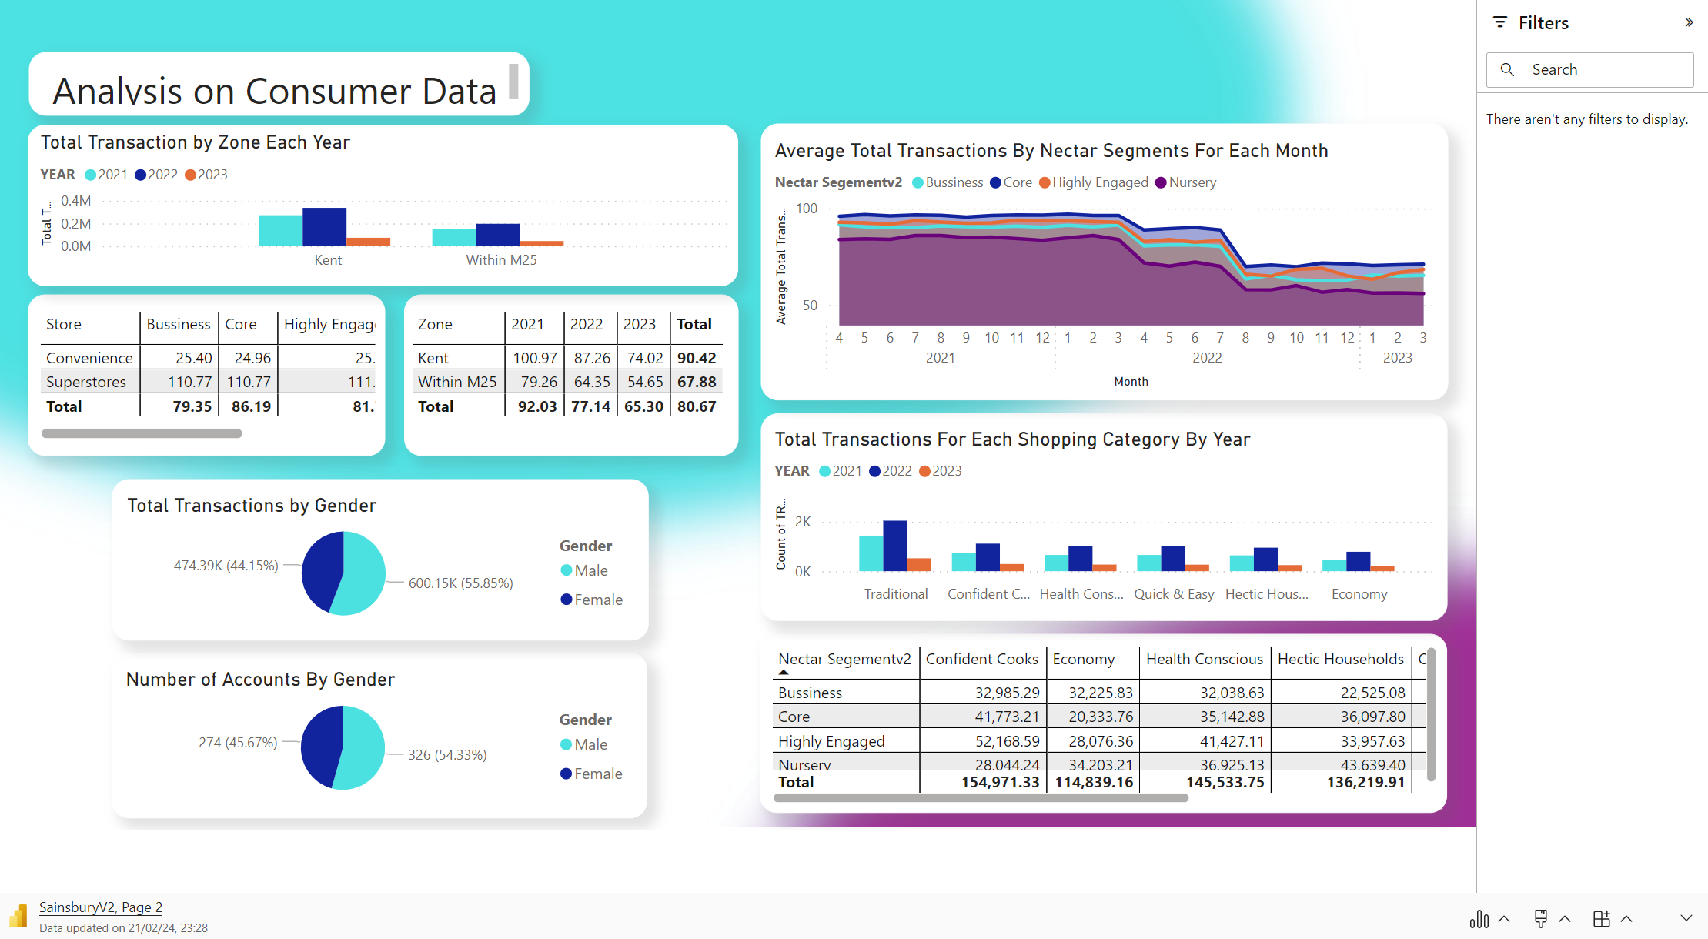
Microsoft Power BI

Slide 7
Sales Performance Analysis
Trend Analysis
Total transactions remained steady from Q2 2021 to Q2 2022 (46k to 49k).
Sudden drop in Q3 2022 to £38,988.24, a 20.4% decrease from August to July 2022. (“Total Transaction by Month” Graph). A reason for this would be due to cost-of-living crisis.
Cost of Living Crisis (C.O.L.C)
A reason for a drop is the Cost-of-Living Crisis: “In the UK, prices of consumer goods and services rose by 9.6% in the year to October 2022” (Office for National Statistics, 2024)
Continuous decrease in total transactions, not recovered by Q1 2023.
Analysis by Shopping Categories
All categories showed steady revenue generation until the start of Q3 2022.
Drop in transaction value across all categories.
The Traditional category faced the biggest loss but still provided the highest total transaction value.
Hectic Households and Quick and Easy categories had the lowest drops, indicating sustained demand.
Shopping Category | Drop in Transaction Value
Confident Cooks | £1364.17
Economy | £1265.49
Health Conscious | £1241.06
Hectic Households | £1202.66
Quick and Easy | £1204.59
Traditional | £3720.28
Insights Gained:
Total Revenue generated decreased due to C.O.L.C, and we still have not recovered in Q1 of 2023.
Hectic Households and Quick and Easy are product categories that faced the least loss.

Slide 8
Sales Performance Analysis
Superstores vs. Convenience Stores:
Superstores consistently generated the same amount throughout the period.
Convenience stores had a lower total transaction value overall.
Total monthly transactions for convenience stores remained steady at 3000-4000 from Q2 2021 to Q1 2023.
Performance Comparison:
Convenience stores performed worse than Superstores.
They would benefit from more loyalty strategies to increase total transactions.
Convenience stores 13, 17, and 20 are the worst performing, especially since relatively new stores opened from Q2 2022.
Impact of Cost-of-Living Crisis:
Superstores experienced a dip in total transaction value at the start of Q3 2022.
The sum of total transactions for all Superstores consistently ranged between 79,000-81,000.
All stores experienced reduced total transactions around Q3 2022, likely due to the cost-of-living crisis affecting Superstores more.
Specific Store Analysis:
Convenience Store 20 showed a progressive reduction in total transaction value, unlike stores 13 and 17.
Insights gained:
The location of Store 20 may not be ideal due to consistent decrease in monthly revenue
Consumers spend more in Superstores rather than in convenience stores.

Slide 9
Customer Segmentation and Behaviour Analysis
Consumer Spending Trends by Nectar Segment:
Core segment spends the most per visit, followed by the Highly Engaged, Business, and Nursery categorys with progressively lower average spending.
Despite a decrease in average spending for the Core segment during the cost-of-living crisis, it still spends the most compared to other segments.
Segment-Specific Spending Patterns:
Core segment consistently spends around £90.00 on average until Q3 2022, then drops to £69.91, but still higher than other segments.
Core segment primarily spends on traditional products, maintaining higher spending ratios even during the crisis.
Category Spending Analysis:
Traditional category experienced the biggest drop in total transactions but still has the highest number of transactions per year.
Each Nectar segment spent the most on traditional products, indicating consistent preference across segments.
Segment-Specific Spending Breakdown:
Nursery segment spent the least in Quick and Easy category.
Highly Engaged segment spent the least in Economy category.
Core segment's lowest spending was in Economy category, while Business segment's lowest was in Hectic Households.
Economy category consistently stands out as the common outlier across segments.
Gender-Based Spending Analysis:
Roughly 54% of account holders are men, compared to 45.67% women.
Men account for a higher total value of transactions compared to women.
Vjgvkh
Insights:
The core nectar segment spends the most on average each visit every month.
All nectar segments spend the most on the traditional products category.
The Economy product category is the worst-performing product category.
There is a higher proportion of men account holders compared to women.

Slide 10
Insights and actions #1
Loyalty Scheme Enhancement:
Average Monthly spending based on the Consumer Nectar segments (Table 1).
Introduce loyalty schemes offering double points for spending £75.00 per visit, incentivizing increased spending.
Adjust target spending thresholds for other segments based on average spending (Table 2).
Adaptive Strategy:
Monitor average total transaction trends to adjust targets quarterly.
Profit Retention Strategy:
Consider reducing the value of rewards while maintaining incentives to maximize profitability.
Personalized Rewards with Machine Learning:
Explore implementing a machine-learning algorithm in the Nectar loyalty app.
Track consumer spending habits to suggest personalized rewards, such as buy one get one half price offers based on purchase history.
Insights considered:
Total Revenue generated decreased due to C.O.L.C, and we still have not recovered in Q1 of 2023.
Hectic Households and Quick and Easy are product categories that faced the least loss.
The core nectar segment spends the most on average each visit every month.
All nectar segments spend the most on the traditional products category.
Table 1
Table 2
Expected Outcome:
- Increase in total revenue and average spending per month
Nectar Segment | Average Spends in Q1 of 2023
Core | £70.80
Business | £65.29
Highly Engaged | £66.16
Nursery | £56.14
Nectar Segment | Average Spends for Double Points
Core | £75.00
Business | £67.50
Highly Engaged | £68.50
Nursery | £58.00

Slide 11
Insights and actions #2
Branch Closure or Conversion to Superstore:
Possible reasons for lower revenue:
Consumer preference for Superstores due to better shopping options.
Competition from nearby supermarket chains affecting foot traffic.
Consider closing down the branch or converting it to a superstore based on findings indicating higher revenue generation by Superstores.
Location-Specific Rewards:.
If factors like consumer preference or competition are confirmed, explore offering location-specific rewards.
Example: Nectar customers receive free items or exclusive offers only at Location 20 to incentivize patronage.
Insights Considered:
The location of Store 20 may not be ideal due to consistent decrease in monthly revenue
Consumers spend more in Superstores rather than in convenience stores.
Expected Outcome:
- Increase Revenue for the store in location 20.

Slide 12
Insights and actions #3
Exclusive Bundle Deals:
Offer better rewards, such as exclusive bundle deals, for products in the Economy products.
Incentivize purchases by providing additional value for Economy category products, potentially increasing sales and revenue.
Advertisement Modification:
Alter advertisement strategies for the Economy category to better appeal to consumer needs and desires.
Highlight benefits, value proposition, and relevance of Economy products to the target audience.
Improve consumer perception and increase sales through targeted marketing campaigns.
Insights Considered:
The Economy product category is the worst-performing product category.
Expected Outcome:
- Improve revenue generated from Economy products

Slide 13
Insights and actions #4
Product Alignment with Nectar Rewards:
Assess product offerings with Nectar rewards to identify any bias towards male demographic preferences.
Modify product assortment or introduce new offerings to better cater to female demographic preferences.
Align product selection with Sainsbury's core value of inclusivity by ensuring representation and relevance for all customer segments.
Insights Considered:
There is a higher proportion of men account holders compared to women.
Expected Outcome:
- Improve Inclusivity

Slide 14
Conclusion
References: Cost of living latest insights (2024) Cost of living latest insights - Office for National Statistics. Available at: https://www.ons.gov.uk/economy/inflationandpriceindices/articles/costofliving/latestinsights (Accessed: 21 February 2024).
Insight | Solution
-Total Revenue generated decreased due to C.O.L.C, and we still have not recovered in Q1 of 2023. -Hectic Households and Quick and Easy are product categories that faced the least loss. -The core nectar segment spends the most on average each visit every month. -All nectar segments spend the most on the traditional products category. | -Introduce more loyalty schemes, such as double points for spending a set amount, targeting Core segment consumers to capitalize on their higher spending behavior and incentivize further spending. - Consider adjusting reward values based on consumer spending trends and explore the implementation of a machine-learning algorithm in the Nectar loyalty app to suggest personalized rewards, enhancing consumer engagement and increasing spending. Top of Form
-The location of Store 20 may not be ideal due to consistent decrease in monthly revenue -Consumers spend more in Superstores rather than in convenience stores. | -Consider closing down the underperforming convenience store at location 20 or converting it into a superstore, as indicated by data showing higher revenue generated by superstores. - If viable, implement location-specific rewards for location 20, such as offering Nectar customers exclusive offers or free items, to attract more business and address revenue decline.
-The Economy product category is the worst-performing product category | -Introduce better rewards, such as exclusive bundle deals, for products in the economy category to incentivize purchases and boost revenue.
- There is a higher proportion of men account holders compared to women. | Align Sainsbury's product offerings with Nectar rewards to appeal more to women, addressing the revenue disparity between male and female Nectar account holders.

